Slide 1

Final Defense Presentation
On the Topic of
CORPORATE RESPONSIBILITY REGARDING THE CONCERN OF GREENWASHING, POLICY AND LEGAL INITIATIVES: A CRITICAL STUDY
Submitted To
Chanakya National Law University
Nyaya Nagar, Patna 800001
Under The Supervision Of
DR. P. P. RAO
ASSOCIATE PROFESSOR
Submitted by
SAUMYA SINGH
Roll No- PL-2121
Ph.D. (Batch- 2021)

Slide 2
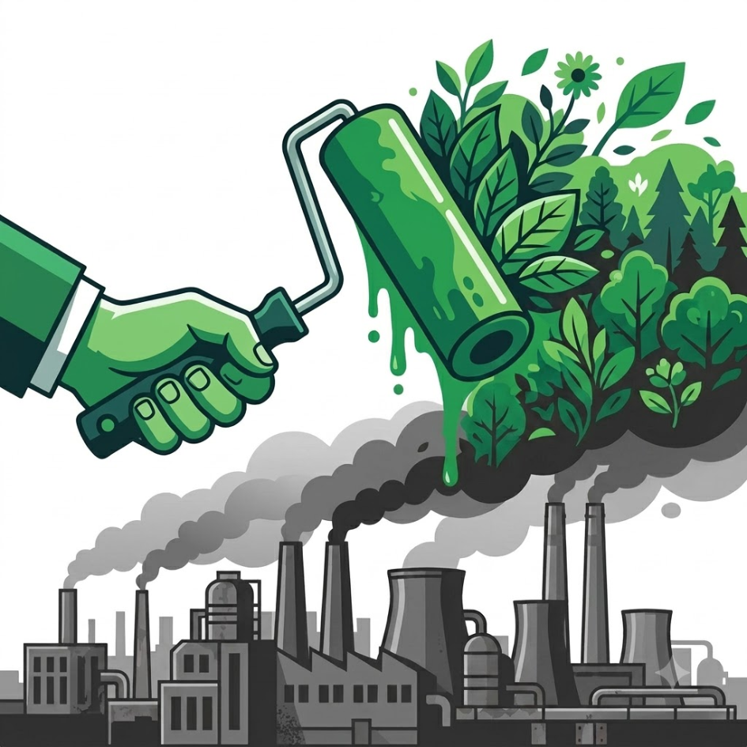
What Is Greenwashing ?
Greenwashing is defined as any misleading, exaggerated, vague, or unsubstantiated environmental claim made by an entity.
The Green Facade (What Companies Show)
• Earthy Imagery & Buzzwords: Earthy Brown or green packaging, green leaves on packaging, and loose terms like "100% Eco", "Natural", ”Recycled”, etc..
• Self-Awarded Badges: Inventing custom green stamps that imitate official third-party certifications.
• Halo Marketing: High-budget PR campaigns highlighting 1 minor eco-feature while ignoring heavy pollution in core operations.
The Hidden Reality (What Stays Hidden)
• Unchanged Operations: Core operations stay heavily dependent on fossil fuels, toxic emissions, and plastic waste.
• Claim Verification Deficit: Zero scientific proof, no independent audits, or verifiable data backing up the claims.

Slide 3
Why Greenwashing Matters To Us ?
Greenwashing is not a distant issue, it directly affects our wallets, our choices, and our future.
OUR WALLET
"The Premium We Pay"
• When we deliberately pay extra for 'eco-friendly' goods, we spend hard-earned money in good faith.
• Too often, that extra premium ends up funding expensive PR campaigns instead of genuine environmental solutions.
OUR CHOICES
"The Illusion of Impact"
• Millions adopt sustainable habits, carrying cloth bags, sorting waste, and choosing conscious brands.
• Deceptive corporate claims make these honest lifestyle choices meaningless while industrial pollution continues unchecked.
OUR FUTURE
"The False Comfort"
• Un-substantiated slogans like 'Net-Zero by 2050' create a false comfort that someone else is solving the climate crisis.
• This false sense of security delays urgent climate action, while extreme weather and toxic pollution directly threaten our families.

Slide 4
The Scale of the Problem in India
Based on available data from authority-based sources
Consumer-facing deception – ASCI Data
Secondary Data from Listed-company studies
Market Scale of ESG Equity and Debt
211 / 211
We looked at two peer reviewed studies highlighting greenwashing of same Nifty 50 firms:
ESG fund AUM
ESG Debt
Grew from US$ 331 million in January 2020 to US$ 1.2 billion by March 2024
Reached US$ 56 billion by Dec. 2024, a 186% increase since 2021
ASCI reviewed 211 environmental ads in its 2024-25 Annual Report.
And every one of them required modification for lack of substantiation.
54% of Nifty 50 (2022)
47% of Nifty 50 (2025)
India is already the fourth-largest emerging market source of sustainable debt globally.
RBI’s 2023 research study found that ESG based stocks have higher returns compared to market.
A CRISIL Report in 2022, discovered that nearly 80% of 586 companies scored weak on ESG parameters.
Greenwashing distorts the information on which consumers, investors and regulators rely on.
It affects consumer choice and capital allocation.
Source: Section 2.5 of Thesis. ASCI, RBI, CRISIL, figures and some peer-reviewed studies, cited in the thesis.

Slide 5
Research Gap
Lack of an integrated analysis
The research gap is not the complete absence of laws or regulations tackling greenwashing, but the absence of an integrated analysis of how those rules translate into enforceable accountability.
Limited doctrinal work on board-level accountability for environmental claims
Section 166(2) of the Companies Act, 2013 creates a statutory expectation that remains under-studied.
Regulatory Fragmentation
The regulatory fragmentation problem has not been sufficiently examined as a structural cause of greenwashing. Green claims are policed across siloed regimes (MCA, SEBI, CCPA/ASCI), creating jurisdictional overlap and an accountability vacuum.
Limited analysis of structural reasons for low Enforcement
The available discussion on the enforcement of section 166(2) of Companies Act remains thin. Beyond Companies Act also, there is lack of doctrinal studies evaluating why SEBI rarely brings deterrent enforcement action against greenwashing.
Limited study on Verification & Assurance Gap
Mandatory ESG disclosure has expanded without corresponding third-party verification capacity, resulting in unverified violations and meagre enforcement of regulation.
MY STUDY ADDRESSES THESE GAPS BY:
Treating greenwashing as a corporate governance failure at the intersection of company law, securities disclosure and consumer protection, proposing an integrated liability framework.

Slide 6
Research Methodology
Comparative and Analytical Legal Research
Primary & Secondary Sources
Indian statutes, judicial decisions (Supreme Court, NGT, SEBI, foreign courts), regulatory instruments (SEBI BRSR, CCPA Guidelines, ASCI Guidelines, etc.), parliamentary reports, research papers.
Jurisprudential Analysis
Hohfeldian decomposition of corporate duties into precise legal relations.
Principal-agent, legitimacy, stakeholder, decoupling, and institutional theory frameworks.
Comparative Legal Analysis
Cross-jurisdictional study of EU, US, UK, Australia, and also developing countries.
Statutory Interpretation
Textual, contextual and purposive analysis of relevant sections of the Companies Act 2013, Consumer Protection Act 2019. And of relevant SEBI Regulations.
Lex Lata vs. Lex Ferenda
Explicit distinction maintained between what the law currently provides and what it should provide (normative reform proposals).
Critical Regulatory Assessment
Mapping design issues and coordination issues between MCA, SEBI, CCPA, ASCI, identifying gaps, penalty arbitrage, and regulatory backsliding.
Nature of Study: Qualitative, analytical, and comparative — focused on identification, analysis and synthesis of legal rules and standards.

Slide 7
Hypotheses
1
2
3
H₁ — Accountability Failure
Greenwashing in India is primarily a consequence of weak corporate governance and the limited operationalisation of board-level environmental responsibility.
H₂ — Liability Shield
The existing legal framework does not impose sufficiently clear, stringent, and deterrent liability for misleading environmental disclosures, thereby enabling corporations to avoid meaningful accountability.
H₃ — Regulatory Inchoateness
In addressing the issue of greenwashing, the present legal mechanism involving different regulatory bodies is inchoate and incomplete.
These hypotheses are mutually reinforcing:
governance-level gaps (H₁) are amplified by non-deterrent sanctions (H₂) and enabled by fragmented regulators (H₃).

Slide 8
Chapterization Scheme
THIS STUDY COMPRISES OF FOLLOWING SIX CHAPTERS-
Introduction
Conceptualizing Greenwashing And Corporate Governance Intervention
Greenwashing: Corporate Responsibility And Accountability
Prevention Of Greenwashing: International Perspective
Indian Regulatory Ecosystem To Prevent Greenwashing
Conclusion

Slide 9
How Greenwashing has evolved and its consequences?
1. CCPA DEFINITION
2. HOW IT HAS EVOLVED
3. MULTI-LAYERED HARM
India’s CCPA Guidelines define greenwashing as "any deceptive or misleading practice" involving: (i) concealing or omitting info; (ii) making vague, false, or unsubstantiated claims; or (iii) using misleading words/imagery emphasizing positive aspects while downplaying harmful attributes.
The unit of deception expanded over time
GREENWASHING
PRODUCT LEVEL | 1986– Claims, seals & imagery
CLIMATE & ENVIRONMENT Delays real decarbonisation
False comfort
CORPORATE LEVEL | 1990s– Brand halo masks operations
FINANCIAL Misdirects green capital
ESG & FINANCIAL | TODAY BRSR Reports, Green Debt, ESG Funds, Net Zero Claims
MARKET TRUST Erodes investor and consumer confidence
Crowds out genuine green business
Wider scope → higher stakes
Answers Research Question 1: What is greenwashing, how has it evolved, and what are its consequences?
Source base: Chapter 2.

Slide 10
India’s Legal Ecosystem For Tackling Misleading Environmental Claims
Constitutional Bedrock:
Articles 21, 48A, 51A(g) of the constitution.
Supreme Court rulings (Tata-Mistry and MK Ranjitsinh) affirm environmental duties and climate rights.
Pillar 1: Consumer Protection
Pillar 2: Securities and Finance
Pillar 3: Corporate Governance
CPA 2019, CCPA, Consumer Courts, and ASCI govern misleading product ads.
• Strength: Broad jurisdiction over advertisements.
SEBI, BRSR, BRSR Core, ESG debt rules, and PFUTP cover investor disclosures.
• Strength: Formalized ESG reporting structure.
MCA and Companies Act place environmental care inside directors' duties.
• Strength: Section 166(2) is textually strong.
Other Complementary Laws & Regulators:
EPA 1986 (environmental standards as objective benchmarks)
NGT (suo motu powers, broad remedial powers, proportional fines, but is a tribunal not regulator)
FSSAI (sector specific, varied enforcement)
BIS Ecomark (voluntary certification)
Trade Marks Act § 9(1)(b) (provides indirect protection by refusing registration of deceptive 'green’ trademarks).
Source base: Chapter 5.

Slide 11
Main Limitations of CCPA Greenwashing Guidelines
Guidelines without Governance Obligations: They prescribe what environmental claims must demonstrate but not what internal governance or processes must exist to ensure such demonstration.
No Board Level Deterrence: Because its remit is restricted to consumer facing products and ads only; the institutional greenwashing such as corporate PR campaigns, annual sustainability overstatements that do not mention any specific product or service are allowed.
Weak Oversight on Future Claims: It permits futuristic claims, without mandatory interim milestone reporting and no independent verification of interim progress or a penalty on non-delivery of these targets.
Visual Imagery & Puffery Loophole: It exempts generic nature visuals and exaggerated talk in advertisements, which leaves scope for greenwashing.
Fixed cap penalties: Not turnover linked. Limited deterrence for big companies.
The Corporate Governance Pathway
• Moves enforcement upstream, requiring verified data before any claim leaves the boardroom.
• Uses Section 166(2) and audit committees to hold leadership responsible for truth in sustainability.
Answers Research Question 2: What are the structural limitations of consumer protection and advertising law in addressing greenwashing and what legal pathways exist through corporate governance?
Source base: Chapter 2 and 5.

Slide 12
Greenwashing as a Corporate Accountability Failure
What a Company Actually Is
Five classic theories of corporate personality are tested in the thesis.
Interpretation says that a company is a real social actor and green promises create legal expectations on the company.
Indian law follows the stakeholder position: Section 166(2) makes environmental care an inherent duty of the company.
Duty
Claim-Right
Privilege
No-Right
1. Broken Duty & no Claimant
2. Abused Communication Liberty
Section 166(2) mandates environmental care, yet affected stakeholders are given no standing (claim-right) to sue.
Management holds commercial freedom (Privilege) to advertise. But this privilege is abused by crossing into deception and unsubstantiated claims.
So, Duty remains purely aspirational and un-enforced.
Managerial Discretion ≠ License to mislead
Power
Liability
Immunity
Disability
3. ESG Related Information Asymmetry
4. Limited Liability Shield
Companies hold informational power as the BRSR disclosures remain unverified; and the public bears the liability of acting on it.
The ‘corporate veil’ shields the corporate beneficiaries. ESG gains stay private. While environmental damage is externalized.
Remedial Flaw: Public lacks upstream verification
Deterrence Failure.
Answers Research Question 3: What are the jurisprudential foundations of corporate responsibility that justify treating greenwashing as a failure of corporate accountability?
Source base: Chapter 3.

Slide 13
Why Section 166(2) of Companies Act Remains Weakly Enforced ?
1
Substantive &
Doctrinal Hurdles
2
Procedural &
Standing Barriers
3
Remedial &
Economic Deficits
Vague terms
"Community," "environment," and stakeholder "best interests" stay undefined.
Business judgment shield
Courts rarely second-guess commercial fiduciary choices.
Precedent gap
No case law links environmental misstatements to a director's breach of duty.
Narrow standing
Ss. 241–244 mismanagement petitions open only to shareholders.
Stakeholders shut out
External parties cannot enforce the environmental duty.
Missing referral bridge
CCPA or SEBI greenwashing findings do not auto-trigger MCA action under s. 166(2).
Ineffective fines
S. 166(7) caps penalties at ₹1–5 Lakh, too small to deter board-level greenwashing.
Short-term bias
Directors favour immediate profit over unpenalized environmental duties.
Answers Research Question 4: What duties of directors, disclosure obligations and assurance requirements, under Indian company and securities law, can ground liability for misleading environmental claims?
Source base: Chapter 3.

Slide 14
Limitations of SEBI's ESG Regime
Design limits
Backsliding
Enforcement Reality
• BRSR covers only Top 1000 listed firms, leaving large unlisted polluters outside.
• Single-materiality focus means impacts on the wider environment stay under-reported.
• Lack of sector-specific metrics weakens data comparability.
• Mandatory audits replaced with soft 'assessment or assurance' option.
• Value-chain reporting deferred and made voluntary, and narrowed (2% threshold / 75% cap).
• Gensol-BluSmart action was triggered by whistleblowers, not routine ESG market scans.
• SEBI Whole-Time Member publicly flagged false BRSR claims in Jan 2025.
• SEBI still lacks a dedicated ESG enforcement team.
2021
BRSR introduced: mandatory for the top 1000 listed entities
2023
BRSR Core introduced: stricter, adds KPIs, mandatory reasonable assurance and value-chain reporting
Dec. 2024
assurance diluted to assessment and value-chain disclosure deferred and made voluntary
2025
scope narrowed further
SEBI's BRSR has just improved ESG disclosure format, but scope, assurance, and enforcement remain too weak to make greenwashing costly.
Answers Research Question 4 (Contd.)
Source base: Chapter 5.

Slide 15
India Has Legal Grounds But Enforcement Is Weak: A comparison
There is doctrinal strength in laws but has not yet been converted into visible, routine enforcement.
Already in Law — But Unenforced
Australia
United States
• Section 166(2) explicitly places environmental protection inside directors' duties, yet not a single director liability case has been reported under it for green claims.
• Supreme Court rulings (Tata-Mistry, Ranjitsinh) affirm environmental duties and climate rights, but narrow legal standing keeps the affected public and civil society from filing claims.
• SEBI's BRSR and BRSR Core formalize detailed sustainability disclosures, while audits remain partial and delayed, leaving the data largely self-certified.
In Australia, its securities regulator, ASIC made 47 greenwashing-related regulatory interventions in just 15 months ending June 2024.
US FTC and SEC brought over 90 greenwashing enforcement actions between 2021 and 2023.
European Union
India
n the European Union, France’s competition authority
alone issued 141 warnings and 114 injunctions for misleading environmental claims.
Comprehensively written rules, but enforcement is scarce.
Source base: Chapter 3, 4, 5.

Slide 16
India's Enforcement Gap Is A Design Problem: A Comparative Study
European Union
Integrated reporting architecture
United Kingdom
Aligned regulators
Australia
Visible enforcement
• CSRD: direct board accountability, double materiality, phased move to reasonable assurance and audits, standardized ESRS format for reports.
• Green Claims Directive: lifecycle substantiation, accredited verification pre-publication
• Turnover Linked Penalties
• FCA rule: environmental claims must be fair, clear, not misleading and evidence-backed
• CMA can fine up to 10% of global turnover for breaking consumer laws
• FCA and CMA act as one aligned enforcement structure, not silos
• Turnover Linked Penalties
• ASIC: 47 greenwashing interventions in the 15 months to 30 June 2024
• AUD 11.3 Million penalty against Mercer Super for misleading ESG disclosures
• ASIC and ACCC treat greenwashing as a joint priority
• Turnover Linked Penalties
Indian Regulatory Design Failures
• No integrated architecture linking Section 166(2), SEBI's BRSR and the CCPA guidelines across the life cycle of a claim.
• No protocol for operational coordination.
• The study finds poor enforcement record not just for section 166(2), but also for SEBI BRSR and CCPA Greenwashing Guidelines.
• Backsliding rather than tightening: BRSR assurance and value-chain relaxations.
• Fixed low cap penalties: CCPA ₹50L, Section 166(7) ₹5L, FSSAI ₹10L, far below global practice.
Source base: Comparative study, Chapter 4, Chapter 5

Slide 17
International Best Practices – A Comparative Benchmark
1
Pre-Approval for Claims
Independent certification required before publishing any green claim (EU GCD, Colombia).
2
Mandatory Third-Party Auditing
Phased move from basic reviews to full financial-grade audits (EU CSRD, Australia).
3
Double Materiality
Disclosing financial risks to the firm AND the firm's real impact on the planet (EU ESRS).
4
Lifecycle Assessment (LCA)
Requiring full cradle-to-grave analysis for all eco-product claims (EU, UK Green Claims Code).
5
Mandatory Scope 3 Emissions
Full supply-chain emissions must be disclosed; cannot hide polluting suppliers (EU, Australia).
6
Reversed Burden of Proof
The company must prove its claim is true; consumers do not have to disprove it (Canada, EU).
7
Specific Rules for Carbon Claims
Strict standards for 'carbon neutral' claims and retiring verified carbon credits (US FTC, EU).
8
Ban on Vague Buzzwords
Outlawing broad terms like 'eco-friendly' or 'green' without clear, measurable proof (EU ECGT, UK CMA).
9
10
Turnover-Linked Penalties
Setting fines at 4% to 10% of total revenue so penalties cannot be dismissed as a minor cost (EU, UK).
Connected Multi-Agency System
Automatic case-sharing and joint investigations between consumer, financial, and company regulators.
Answers Research Question 5: What comparative regulatory models and enforcement techniques have emerged in other jurisdictions to control greenwashing, and what design lessons do they offer?

Slide 18
Other Gaps in Indian Regulatory Ecosystem
Gap 1
Definitional Fragmentation
• CCPA, SEBI, and ASCI define greenwashing differently based on separate mandates.
• Key technical terms ('carbon neutral', 'net zero') remain legally undefined in India.
Gap 3
Scientific & Technical Verification Gaps
• Regulators lack specialized in-house expertise in carbon accounting and lifecycle audits.
• India still lacks joint enforcement teams, shared technical experts or a unified enforcement database for greenwashing matters.
Gap 2
Regulatory Proliferation & Ambiguity
• A single green claim touches CCPA, SEBI, MCA, FSSAI, and MoEFCC simultaneously.
• Green Taxonomy Paradox: May 2025 Taxonomy added a parallel voluntary framework without harmonizing existing rules.
• No lead regulator, no mandatory data-sharing, and no joint investigative capacity.
Answers Research Question 6: How do fragmentation, overlap, weak coordination, and limited enforcement in India's regulatory ecosystem, impede accountability for greenwashing?

Slide 19
General Suggestions For Regulatory Reform
1. Institutional Integration
2. Lead Regulator Model
3. Standardised Verification
4. Proactive Surveillance
5. Enforcement Capacity
Permanent inter-regulatory council linking MCA, SEBI, CCPA, MoEFCC, CPCB, BIS and FSSAI
Designate a coordinating agency
Replaces multiple conflicting inspections with one coordinated approach.
Ex-ante claim substantiation
Accredited third party verifiers for each type of environmental claim verification
Routine market sweeps
Cross-check environmental claims against CPCB/SPCB pollution records
In-house ESG surveillance capacity for relevant regulators like SEBI.
Shared carbon-accounting and GHG-assurance expert panels.
Answers Research Question 7: What legal and policy recommendations can create an integrated liability framework that holds corporations accountable for misleading environmental claims?
Source base: Chapter 6.

Slide 20
Specific Recommendations for Legal Reform
Companies Act / MCA
SEBI / Securities law
CCPA / Consumer law
• Direct Statutory Standing: Insert new Sec 166(8) empowering affected persons, creditors, and consumer NGOs before NCLT without Sec 244 shareholding caps.
• Mandatory ESG Committee: Insert new Sec 135A requiring Board ESG Committee for ex-ante claim pre-approval.
• Whistleblower Protection: Amend Sec 177(9) vigil mechanism to explicitly cover environmental misrepresentations under Sec 166(2).
• Turnover Penalties & Disqualification: Amend Sec 166(7) to penalise misleading claims up to 1% turnover (min ₹5 Cr) + up to 3-year Director Disqualification under Sec 164(2)(b).
• Repeal Backsliding / Restore Rigour: Amend BRSR to mandate Reasonable Assurance & full Scope 3 Value Chain Disclosures.
• PFUTP Fraud & Referral Bridge: Classify material ESG misstatements as fraud under PFUTP Regulations + mandatory referral to MCA.
• Double Materiality: Mandate Impact Materiality alongside Financial Materiality.
• ESG Rating Providers (ERPs): Introduce minimum competence and certifications for ESG analysts.
• Binding Sec 101 Rules: Elevate 2024 Guidelines into formal delegated legislation.
• Turnover Fines & Corrective Ads: Amend Sec 21 to impose 1% to 4% turnover penalties + Mandatory Corrective Advertising of equal prominence and duration.
• Narrow Puffery (Guideline 3(h)): Claims should require published transition plans and budgets.
• Claim-Specific Schedules: Prescribe statutory testing benchmarks specific to the type of environmental claim.
Answers Research Question 7 (Contd.)
Source base: Chapter 6.

Slide 21
Thank You
Concluding Imperative
Without truth in corporate environmental claims, clean investment cannot reach real climate solutions, and consumers cannot make genuine sustainable choices. Stopping greenwashing is essential not just for fair financial markets, but for the health of our planet.

